Slide 1
CS/RBE 549 COMPUTER VISION
LECTURE 10 – EDGES AND GAPS

Slide 2
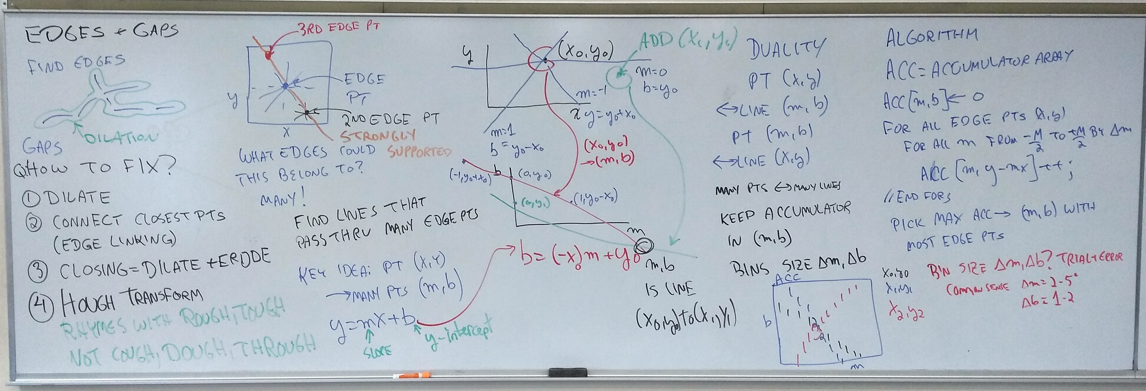

Slide 3
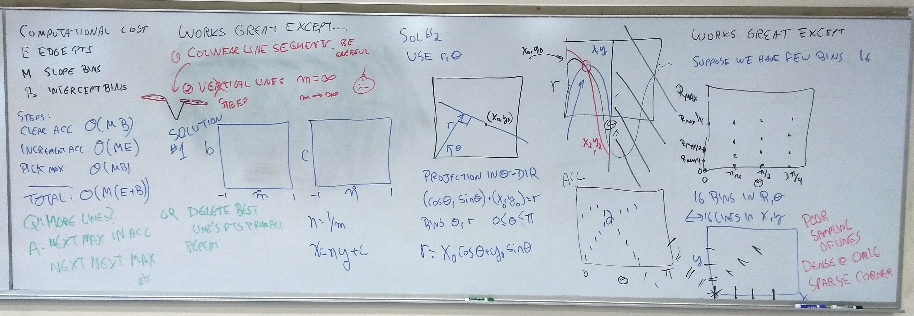

Slide 4
